Slide 1


HUMANLY INTERACTIVE VR
SUPERVISED BY:
Dr. Shimaa Ibrahim

Slide 2
Ehsan Ahmed El-Saeed
Laila Mahmoud Abd El-Rahim
Muhammad Mustafa Abd El-Fattah
Raafat Ahmed Muhammad
Toqa Magdy Fouad
Kirollos Atef Ibrahim
Mina Latif Lotfy
Omar Khaled Abd El-Hafiz
Soad Samir Fawzy
Team Members
LIONEL BARRYMORE
Notes:
No slide master

Slide 3
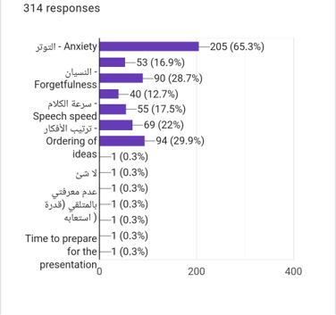
Motivation
According to the survey we made:
The most significant problems
Anxiety
Ordering of ideas
forgetfulness
Speech Speed

Slide 4
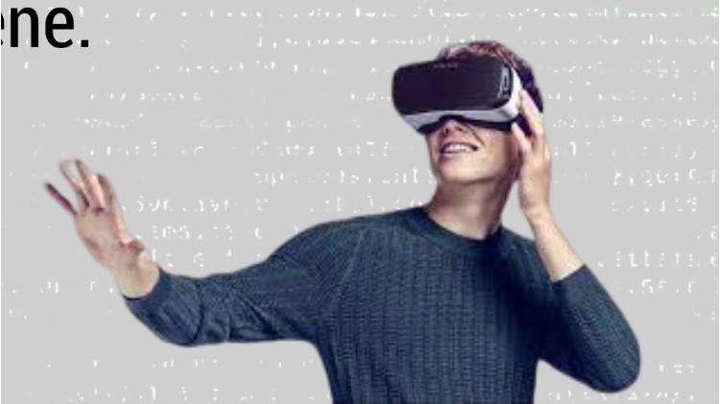
What is our project?
Our project is a VR platform that can help in solving the problems that most people face during giving a presentation by allowing them to practice on their own and get the feedback they need to improve their presentation.
The project is mainly a scene consisting of a hall filled with characters that react to the presentation using facial expressions or ask questions relevant to the presentation.

Slide 5
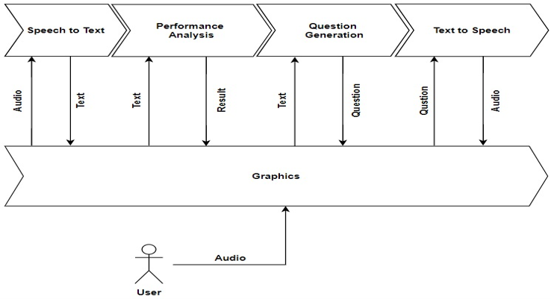
Project consists of 5 phases

Slide 6
SPEECH TO TEXT

Slide 7
Why using Speech To Text?
There have been other methodologies that work on the Voice or the wavy nature of speech but haven’t been successful as text-based methods.
Using speech to text opens the way of using NLP and NLU for understanding what user wants to say in more efficient way.

Slide 8
Why using Speech-To-Text
in our project?
For performance test that counts the number of word in every couple of minutes.
Our pre-trained model that takes a text as input not voice input.

Slide 9
Speech To Text service providers
IBM Watson Speech To Text
Support very small amount of supported languages.
Functions as keywords spotting and labeling of speakers are available in beta version.
The price is flexible according to time of process.
Amazon Transcribe
Not supporting real time mode.
Support for telephony audio.
Is able to recognize multiple speakers and label their voices in the text.
Price is free for 12 months (60 minutes per month).

Slide 10
Google Cloud API
Supports more than 110 languages.
API can work both in batch and real-time modes.
Stable against side noises in the audio.
Filters the wrong words relative to context.
The system is built using deep neural networks and can be improved over time.
The price is flexible according to time of process.
According to this comparison we used Google Cloud API.

Slide 11
How to use Google Speech To Text API
To enable Google API we need to create service account.
Download private key as JSON file.
Send JSON authentication code in API request.
Sending records of 10 seconds to the cloud.
Receiving text word by word.

Slide 12
Performance Analysis
Every 10 seconds we count the number of words in these seconds:
If number of words between 18:25, It is a good rate.
If number of words is less than 18 or more than 25, It is a bad rate.
After 2 Minutes we count number of good, too slow and too fast rates
If number of ‘good’ rates are more than 6 (the half), print “Good Rate” to inform the presenter to continue in this rate.
If number of ‘too fast’ rates are more than or equal number of ‘too slow’ rates, print “You are too fast” to inform the presenter to decrease his speed.

Slide 13
QUESTION GENERATION

Slide 14

Introduction
Make our app more realistic.
Enable interaction between presenter and characters in the app. One of the characters asks the presenter a question.

Slide 15
Quick Start
Previously: Rigid heuristic rules were used to transform a sentence into related questions.
Currently: Neural network method is used to generate factoid questions from structured data.
Dataset
SQuAD dataset, constructed using Wikipedia articles.
The answers are labeled as subsequences in the given sentences by crowed sourcing.
Contains more than 100K questions which makes it feasible to train our neural network models.

Slide 16
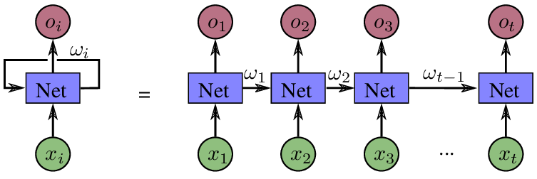
RNN Seq2Sec Models

Slide 17
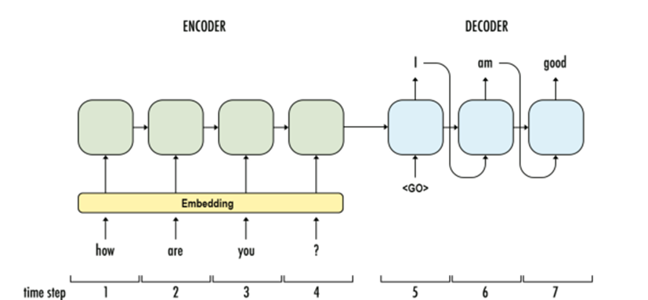
NQG Framework
Construction: LSTM/GRU Encoder and LSTM/GRU Decoder + Attention.
Attention involves focusing on certain parts.

Slide 18
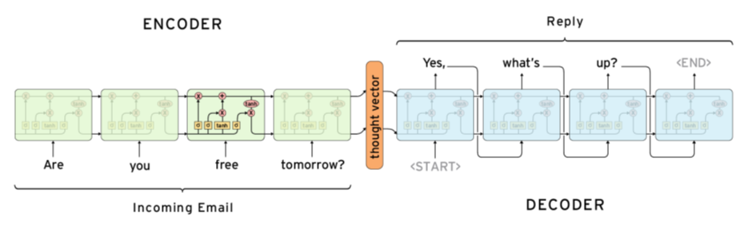
Issues with LSTM Seq2Seq
Slow
No use of Parallelization (Not using GPU)
What are the other options?

Slide 19
Attention is ALL you need!

Slide 20
Attention
is ALL
you need!
To solve no-parallelization issue, another problem has arisen. How to keep the sequence preserved!!
Attention is ALL you need provided “Positional Encoding”

Slide 21
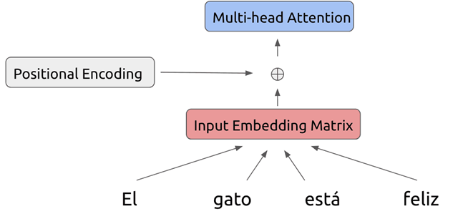
Positional Encoding
Encode the position of the word in the sentence as explicit feature.
Merge it with word embedding through merge layer which could be: concatenation, sum, average, … etc.

Slide 22
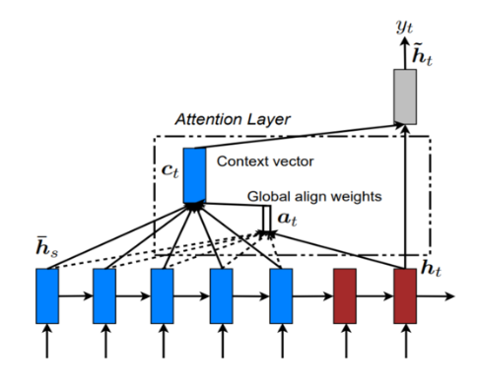
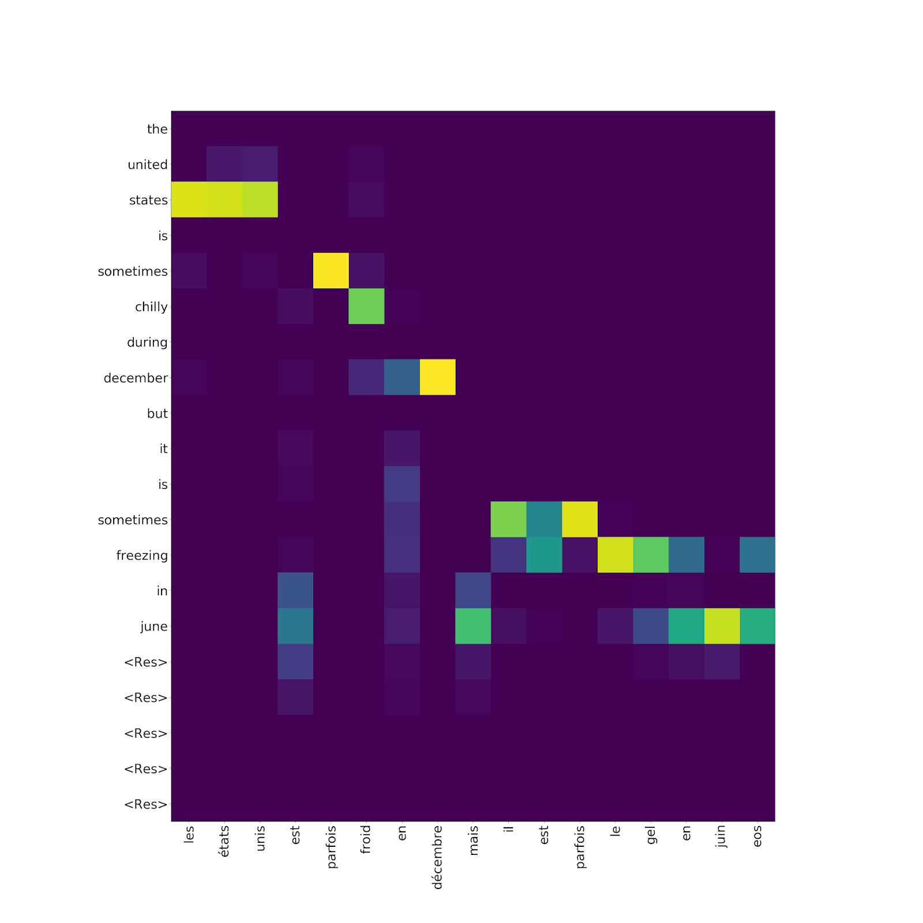
Context is best handled by attention in seq2seq
Attention is just Gating mechanism → Fast
If you have the alignment weights can efficiently encode and decode based on context

Slide 23
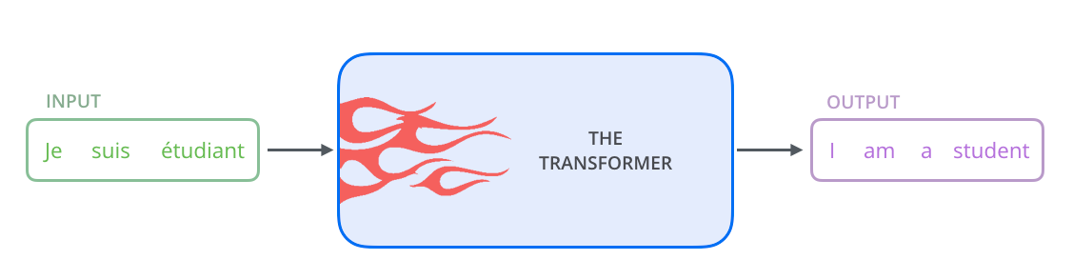
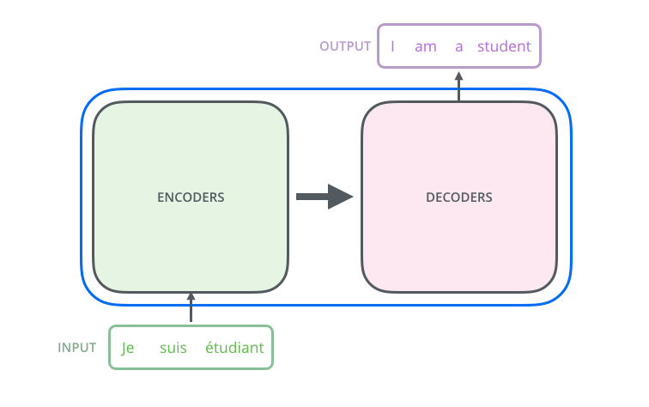
TRANSFORMER

Slide 24
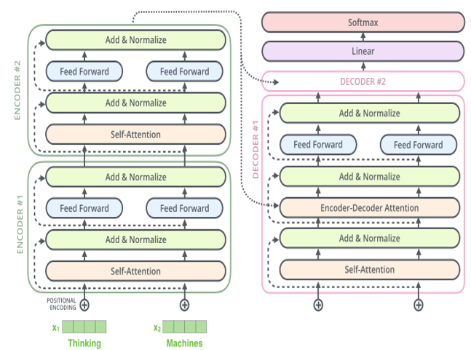
Building Blocks
Encoder:
Positional Encoding
Self-Attention
Add &Normalize
Feed forward
Decoder:
Encoder-Decoder attention (masking)
Add &Normalize
Feed forward
Positional Encoding
Softmax output

Slide 25
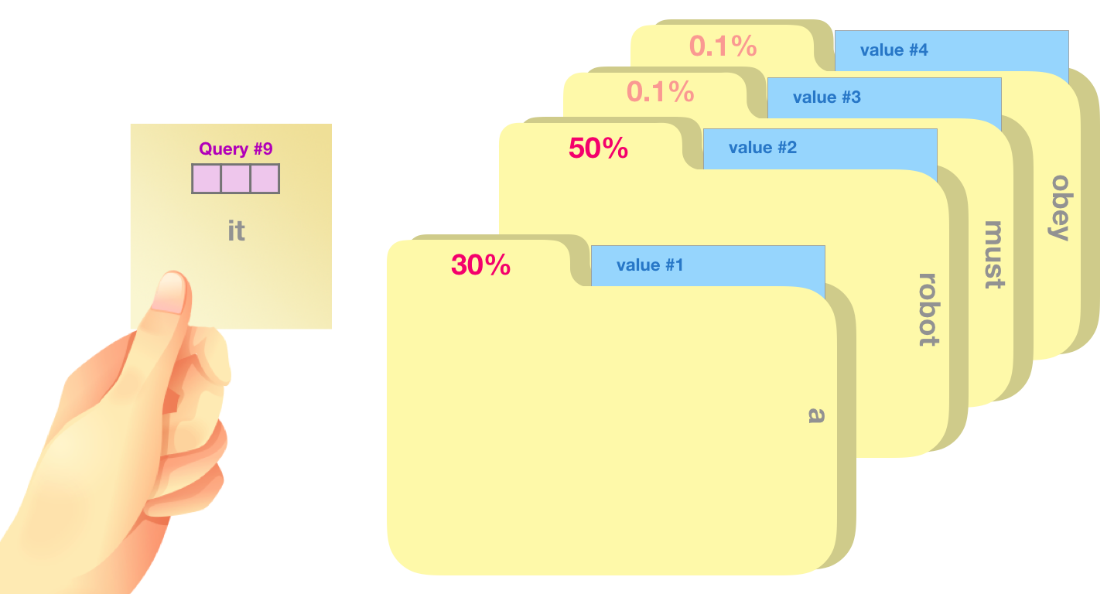
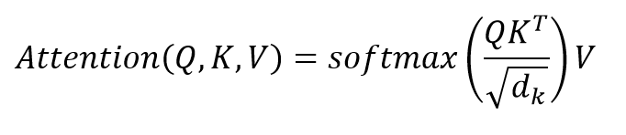
Self-Attention
Query = A feature detector (is_verb, is_name, ….)
= Word as feature detector
Keys = Context words to extract the feature from
= Word vector as context
Value = Detected feature(s) value
= Word features (latent factors)

Slide 26

Self-Attention

Slide 27

Self-Attention

Slide 28
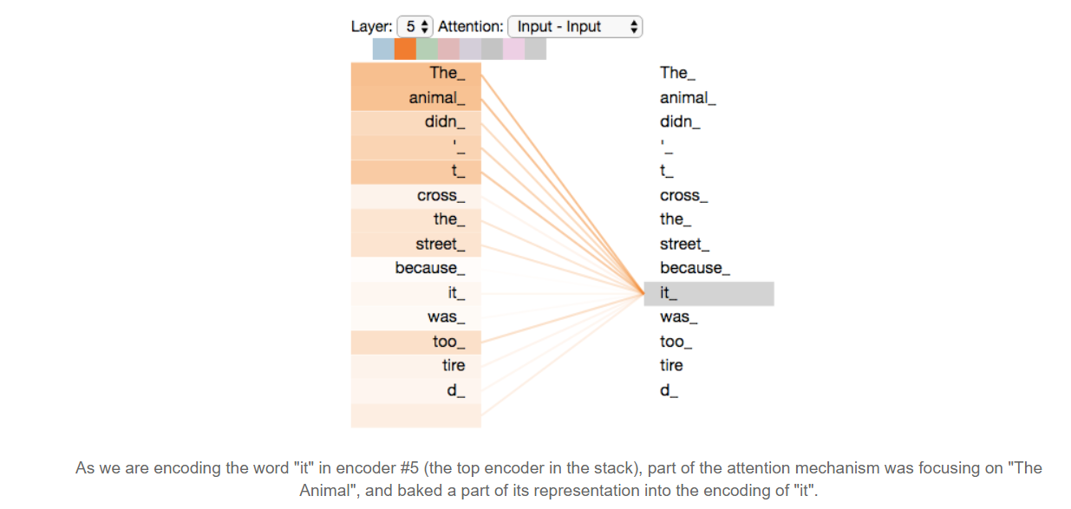
Self-Attention

Slide 29
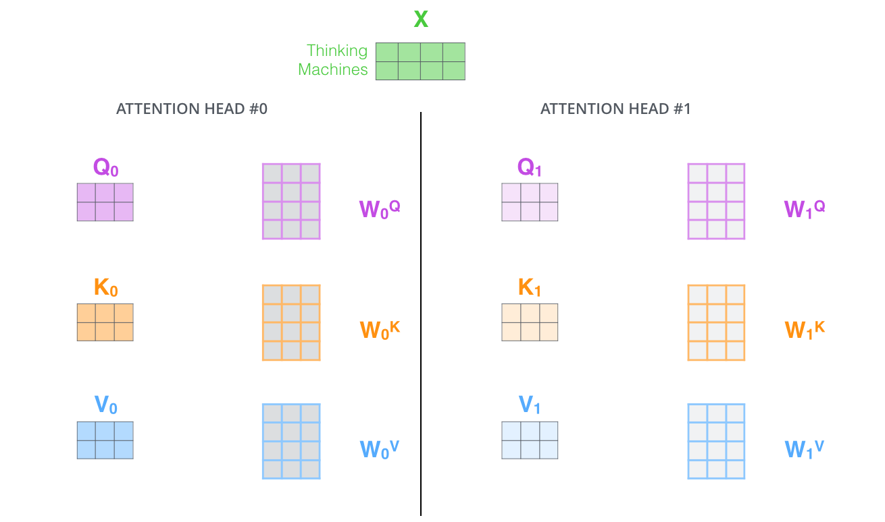
Multi-head attention

Slide 30
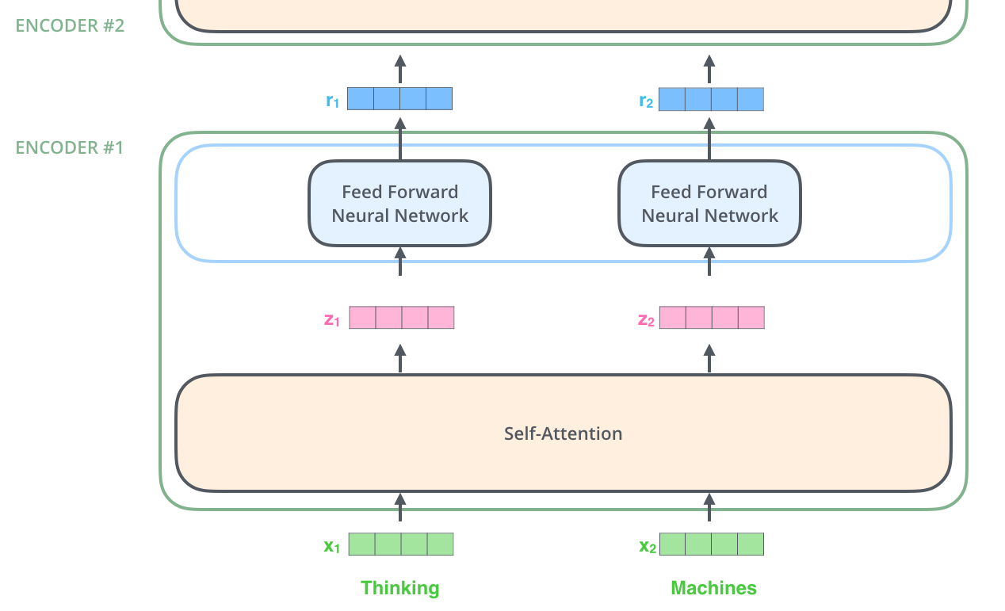
Mutli-head Attention + Feed Fwd
The next stage is Feed Fwd (FFN), which expects one “z”
How to handle this, while we now have 8 z’s from 8 heads?
→ Concatenate

Slide 31
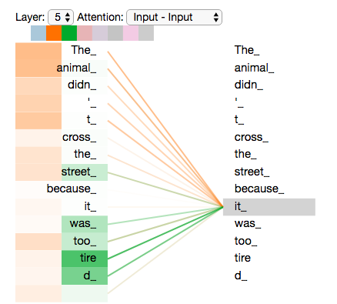
Mutli-head Attention
As we encode the word "it", one attention head is focusing most on "the animal", while another is focusing on "tired" -- in a sense, the model's representation of the word "it" bakes in some of the representation of both "animal" and "tired".

Slide 32

Putting all together

Slide 33

Add &Normalize

Slide 34

Decoder
Same as Encoder, except Self-Attention.
In the decoder, the self-attention layer is only allowed to attend to earlier positions in the output sequence.

Slide 35

Parallelization

Slide 36
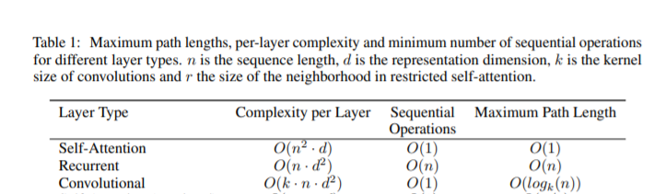
Scalability

Slide 37
BERT & GPT

Slide 38
Transfer Learning
Transfer learning is a research problem in machine learning that focuses on storing knowledge gained while solving one problem and applying it to a different but related problem.
Types:
Same Domain, Different Task
Different Domain, Same Task

Slide 39
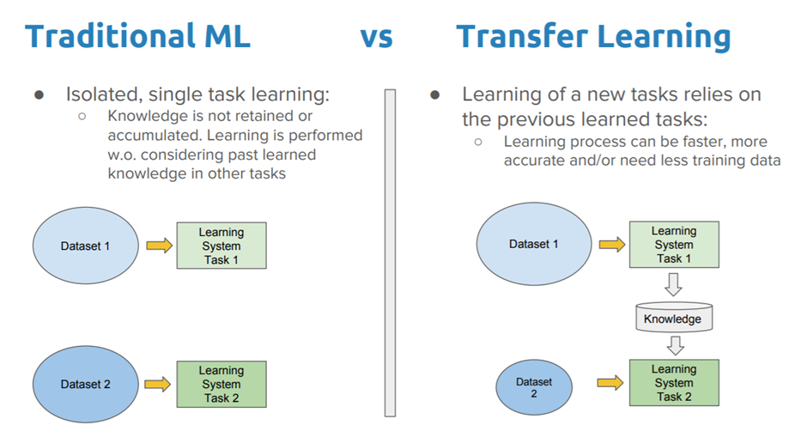
Transfer Learning

Slide 40
BERT
Bidirectional Encoder Representations from Transformers is a technique for NLP pre-training developed by Google. BERT is a multi-layer bidirectional Transformer encoder. Unlike previous models, BERT is a deeply bidirectional, unsupervised language representation, pre-trained using only a plain text corpus.

Slide 41
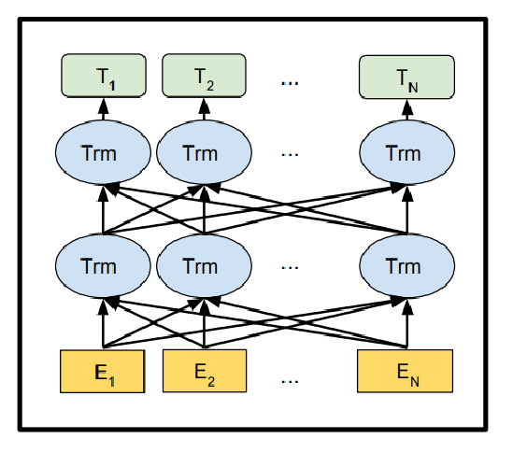
What is [B]iderctional in BERT

Slide 42
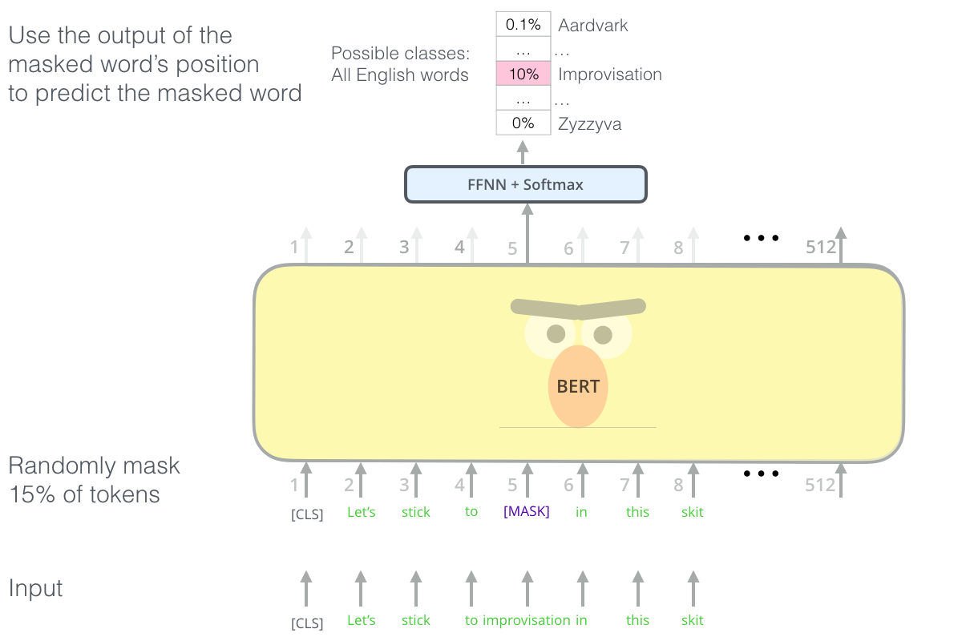
Pretraining BERT: Masked Word Prediction

Slide 43
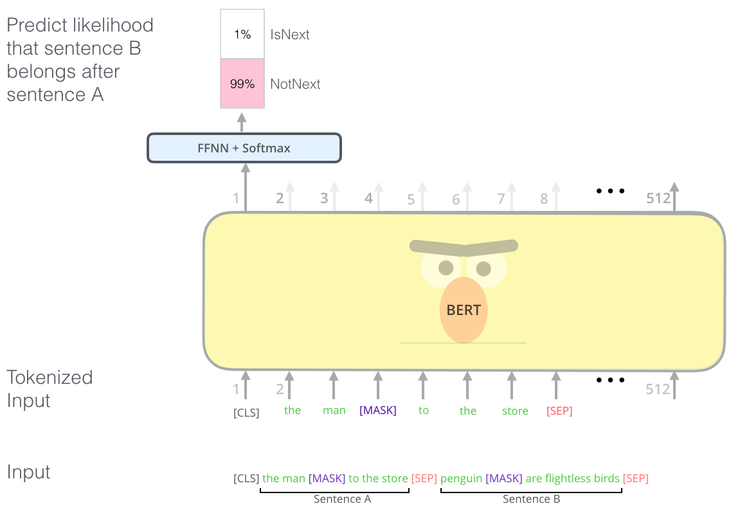
Pretraining BERT: Next Sentence Prediction

Slide 44
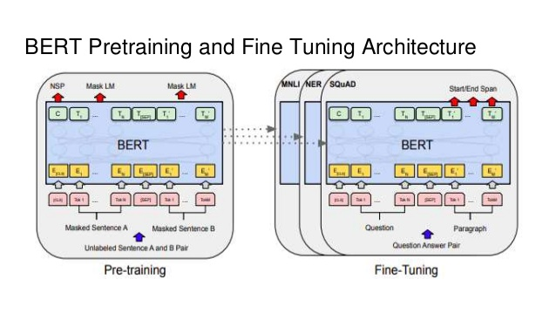
BERT

Slide 45
GPT
Generative Pretrained Transformer is a Transformer-based generative model where unlike BERT the decoder transformer is replicated and stacked. Its current version is GPT-3 released in May 2020.

Slide 46
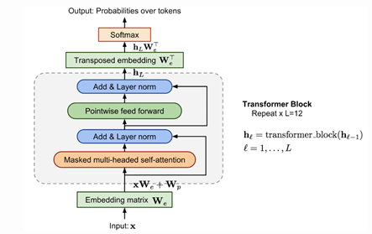
GPT Architecture

Slide 47
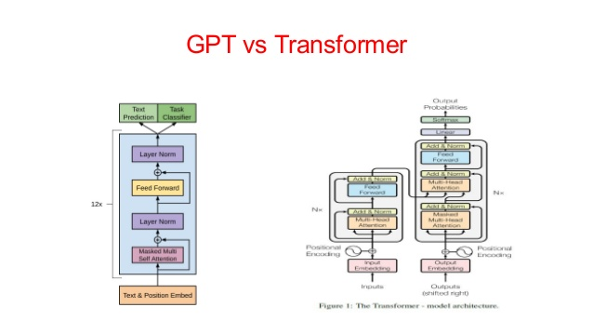
GPT vs Transformer

Slide 48
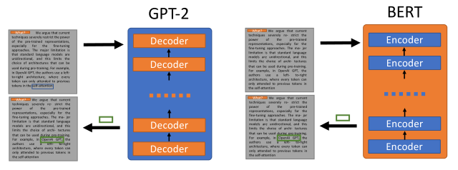
GPT vs BERT

Slide 49
UNILM
Unified pretrained language model

Slide 50
INTRODUCTION TO UNILM MODEL
UNILM is the state of the Art in NLP tasks it is better than BERT,GPT,ELMO .
UNILM can be configured, using different self-attention masks to aggregate context for different types of language models, and thus can be used for both NLU and NLG tasks.

Slide 51
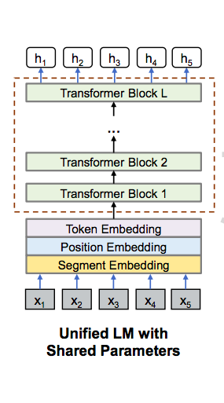
ARCHITECTURE OF UNILM MODEL
It is consist of 24-layer Transformer with 1024 hidden size, and 16 attention heads, which contains about 340M parameters .
Has a little difference from standard transformer (Segment Embedding Layer - Masked Matrix in the Encoder).

Slide 52
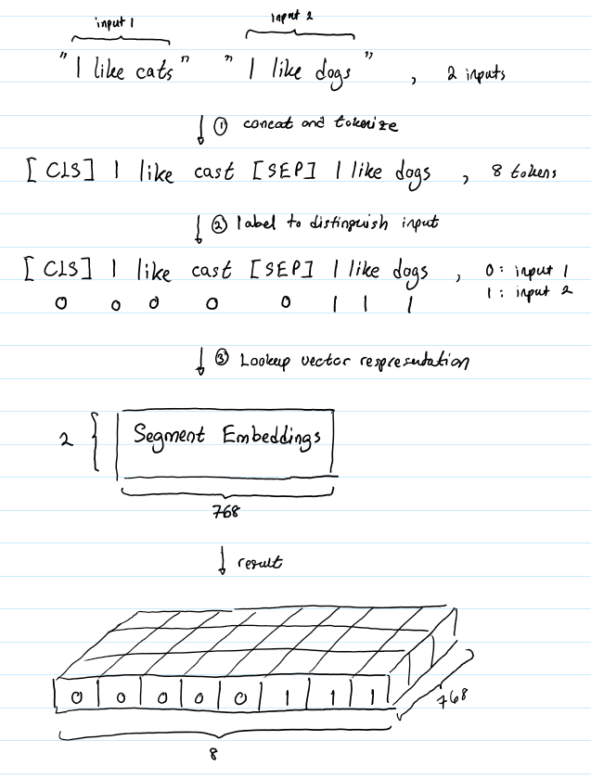
INPUT REPRESENTATION
([SOS] S1 [EOS] S2 [EOS]) .
Texts are tokenized to subword units by WordPiece.
Token embedding
Segment embedding
Positional embedding

Slide 53
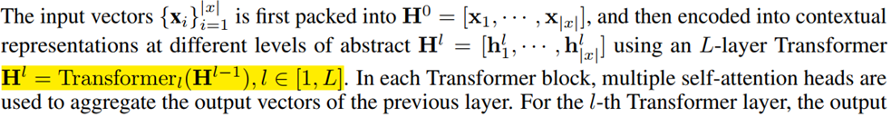
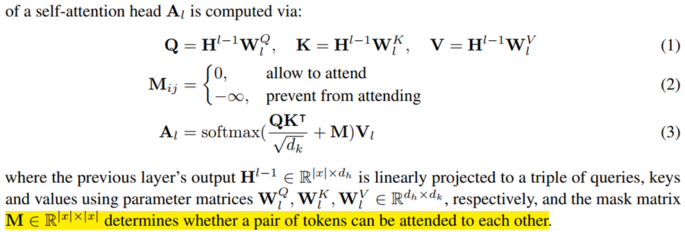
MULTI-LAYER TRANSFORMER

Slide 54
PRE-TRAINNING OBJECTIVES
We randomly choose some WordPiece tokens in the input and replace them with special token [MASK]. Then, we feed their corresponding output vectors computed by the Transformer network into a softmax classifier to predict the masked token.
The parameters of UNILM are learned to minimize the cross-entropy loss computed using the predicted tokens and the original tokens .
We pretrain UNILM using four cloze tasks designed for different language modeling objectives.

Slide 55
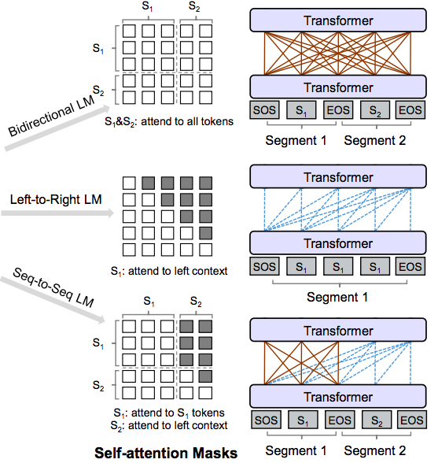
PRE-TRAINNING OBJECTIVES - CONT
Unidirectional LM
Bidirectional LM
Sequence-to-Sequence LM

Slide 56
PRE-TRAINNING SETUP
The overall training objective the sum of different types of LM objectives .
1/3 of the time we use the bidirectional LM objective.
1/3 of the time we employ the sequence-to-sequence LM objective.
1/6 of the time we employ the left-to-right LM objective.
1/6 of the time we employ the right-to-left LM objective.
UNILM is initialized by BERT-LARGE, and then pre-trained using English Wikipedia and BookCorpus .

Slide 57
FINE-TUNING FOR QUESTION GENERATION
DATASET : we used the inverted SQuAD dataset.
The question generation task is formulated as a sequence-to-sequence problem “[SOS] text [EOS] question [EOS]” .
The model is fine-tuned by masking some percentage of tokens in the target sequence at random and learning to recover the masked words.
The training objective is to maximize the likelihood of masked tokens given context.

Slide 58
INTERFACING MODEL & TEXT TO SPEECH

Slide 59
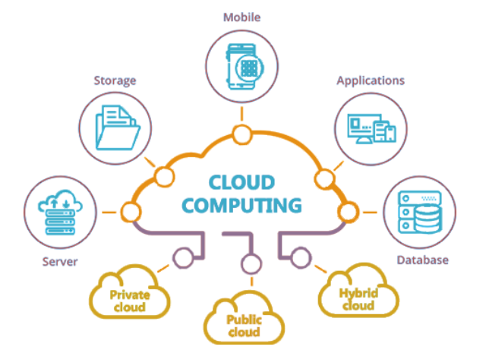
Cloud Computing
A term referring to the computer resources and systems available on demand via the network, which can provide several integrated computer services without being restricted to local resources for the purpose of facilitating the user.

Slide 60

Google Cloud
computers and hard disk drives, and virtual
resources, such as virtual machines (VMs).
This distribution of resources provides several benefits, including redundancy in case of failure and
reduced latency by locating resources closer to clients. This distribution also introduces some rules about
how resources can be used together.

Slide 61

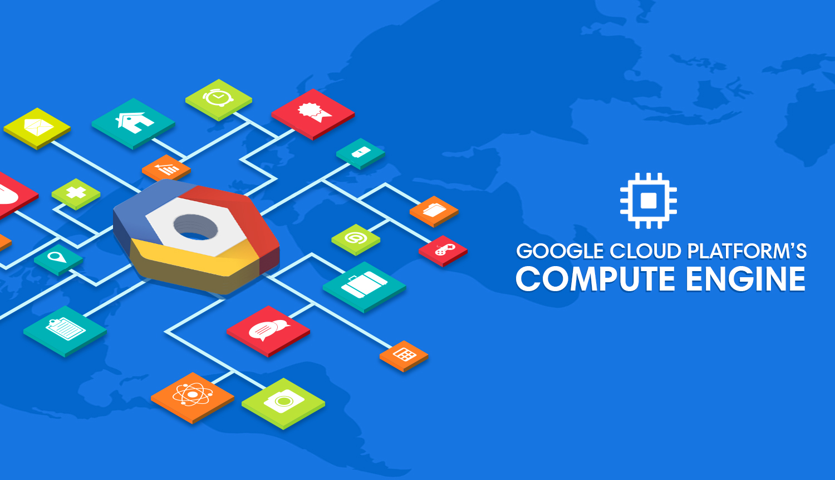
App Engine VS Compute Engine

Slide 62

Why to choose Compute Engine?
When we tried to use Google App Engine, we faced a problem that there is no GPU therefore we cannot install NVidia driver and cannot use CUDA, so we used Google Compute Engine.

Slide 63
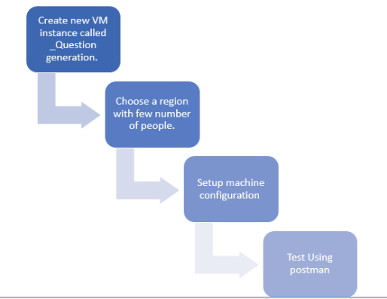
Deploying UniLM Model on cloud

Slide 64
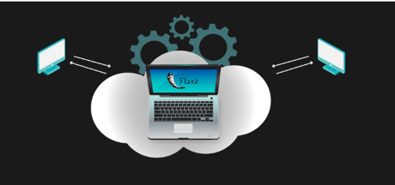
Flask
Flask is some code already written for us in Python that makes it easy to get up and running with a simple web application that has a lot of features that can be useful as we go about building web applications, including managing HTTP requests and rendering templates applications
-@app.route function

Slide 65

Getting random Question
- Each sentence takes about 20 seconds, so every minute 3 sentences are available for the server to return 3 questions.
- Every minute one of the audience requests to ask a question and the request takes 30 seconds, so the
difference between the questions is about two minutes.

Slide 66
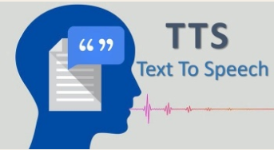
Text to speech
- The last stage the application made HTTP request and sent an array of sentences to the server, server ran the model and generated questions, sent these questions back to the application.
- Voice is configured as female’s voice and when the character is a man, voice is configured as male’s voice .

Slide 67
Problems you may face
1- Version of Text-to-speech conflicts with speech-to-text :
Use version 1.1.0 of TTS and version 1.3.1 of STT.
2- when you try to run Text to Speech service on android platform, error in the GRPC files appears:
Copy the file named libgrpc_csharp_ext to assets
3- Returned mp3 file isn't seen in the android files:
save it using this function which determine the application data path String.
questionPath = Path.Combine(Application.persistentDataPath,"question.mp3");

Slide 68
Graphics

Slide 69
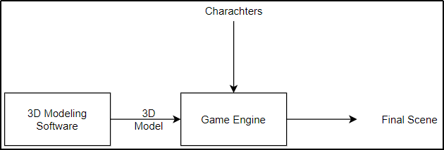
Introduction
build a scene similar to a simple lecture hall
The idea is to build a scene similar to a simple lecture hall to give the user the feeling of authenticity when using the application.
What 3D modeling software to use?
What game engine is best suitable for our needs and our time plan
Should we design the characters or get some predesigned characters?

Slide 70
Scene Modeling
3D modeling programs available
3D modeling programs are available to use like 3Ds Max, Maya, Blender and we have to choose one them for our project. We had to decide which one based on ease of use and how long would it take to have it ready and how good is the software actually is.
3Ds max was best bet
Its offers simple interface for both beginners and professionals with some easy to follow tutorials and documentation and we had some previous experience using it so it seemed to be a great choice for our project.

Slide 71
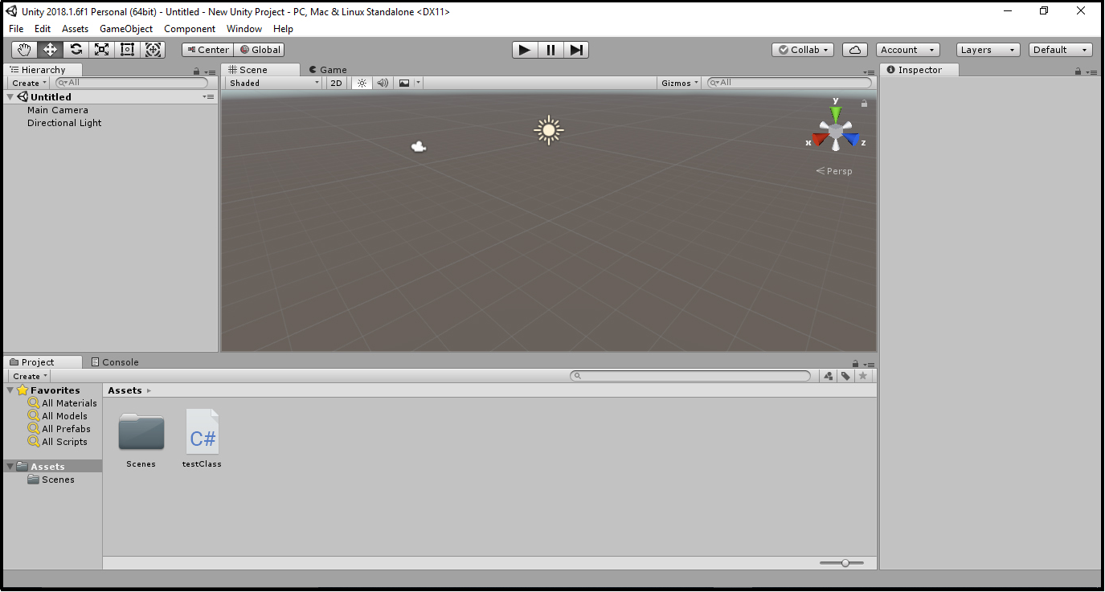
Game Engine
A game engine is a software development environment designed for people to build video games
Unity Vs Unreal Game Engine.
Unity has more available resources to learn from and game models and packages to experiment with compared to Unreal Game Engine and the second issue is now resolved.
Unity:

Slide 72
Characters and Animations
Character design is hard
Character design is hard and tedious process and very time consuming, as we have to use a software to first design the shape, looks of the character, rig it and later export it to Unity.
Use free rigged characters that are available
An easy approach to this problem is use free rigged characters that are available on the internet and use them directly rather than designing them from scratch
Mixamo and Unity’s asset store characters

Slide 73
3Ds Max
A computer graphics program for creating 3D models,animations, and digital images.
Interface
It has a workspace to design the scene and many tools to create it also to modify on the scene
Designing
The first stage is to design the scene in a comfortable and realistic way. We use some tools to design it like (boxes, cubes, cylinders) and many other shapes to design chairs, stairs, board, laptop, projector, clock and also microphone combine them all together to form the scene.
Lighting and Materials (V-Ray and materials)
Rendering (Progressive and Bucket)

Slide 74
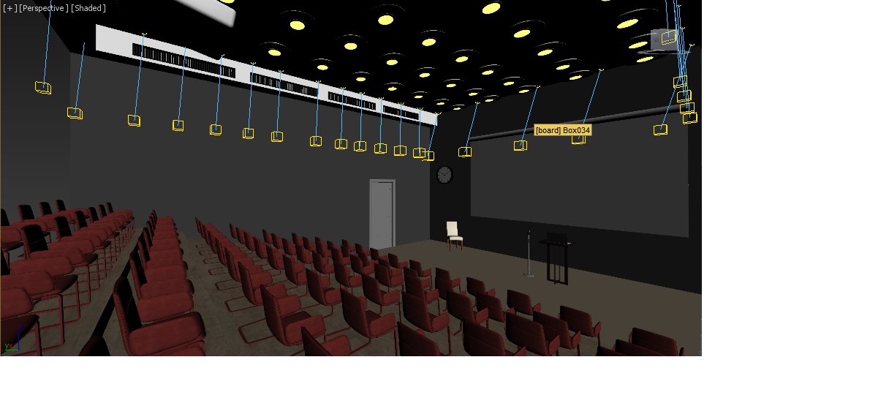
3d max Scene

Slide 75
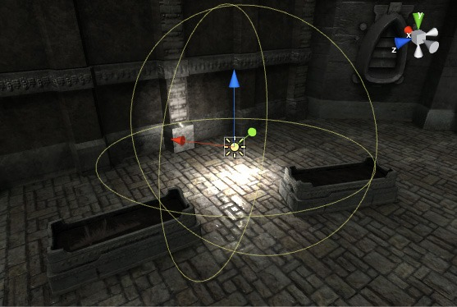
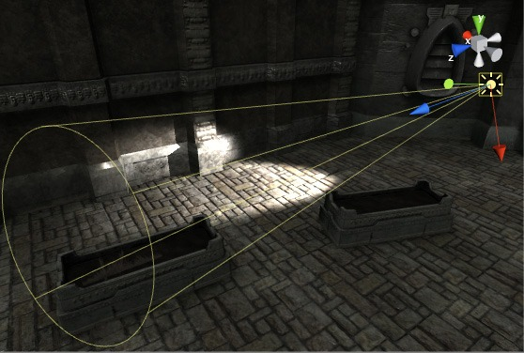
Unity
Unity is a 3D/2D game engine and powerful cross-platform IDE for developers As a game engine, Unity is able to provide many of the most important built-in features that make a game work.
Lighting
Spot light
Directional light

Slide 76
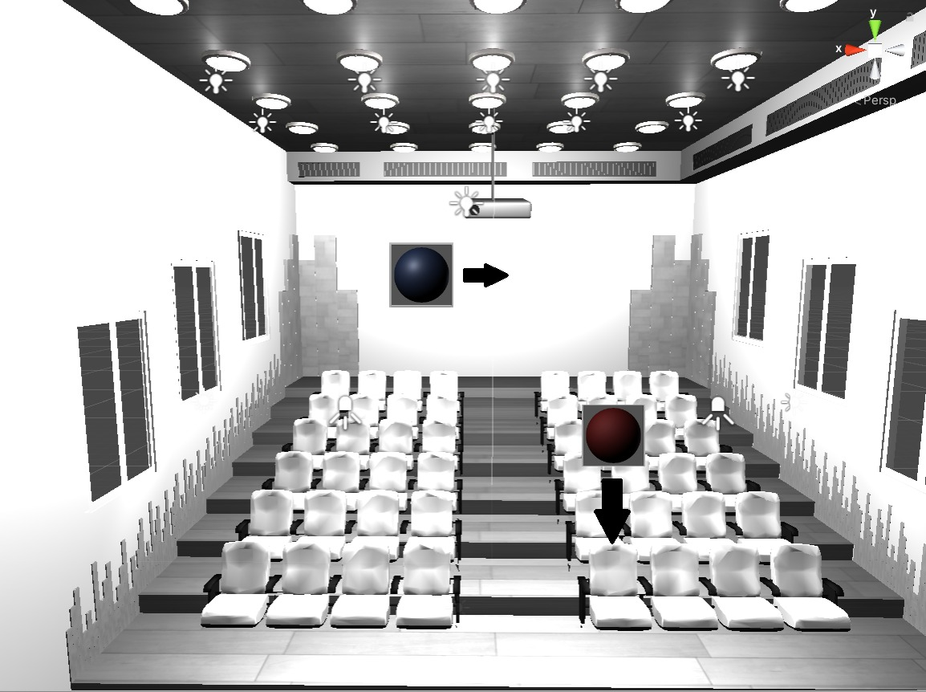
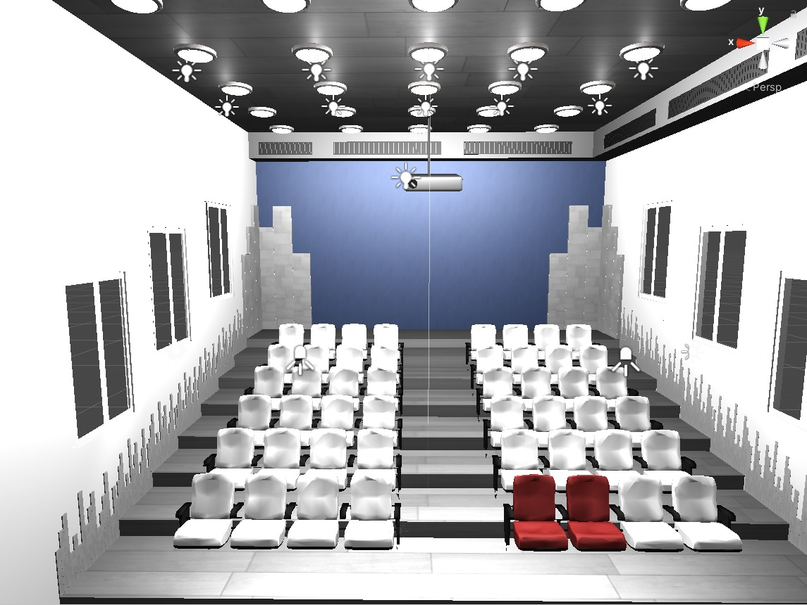
Materials

Slide 77
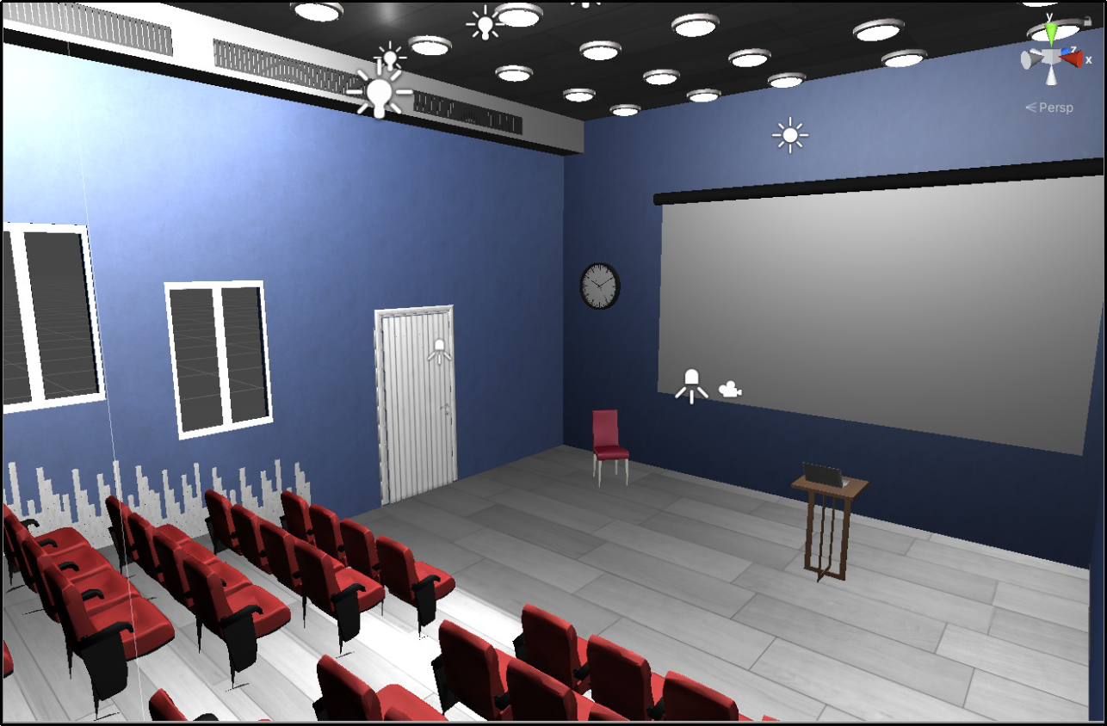
Unity Scene

Slide 78
Characters And Animation

Slide 79
Characters
To imitate a real presentation, we need to have characters that are interactive and can give feedback.
The best way to reflect the user’s performance is by using facial expressions on the characters.
For this reason, we had to find characters that we can control their faces, not only their bodies.

Slide 80
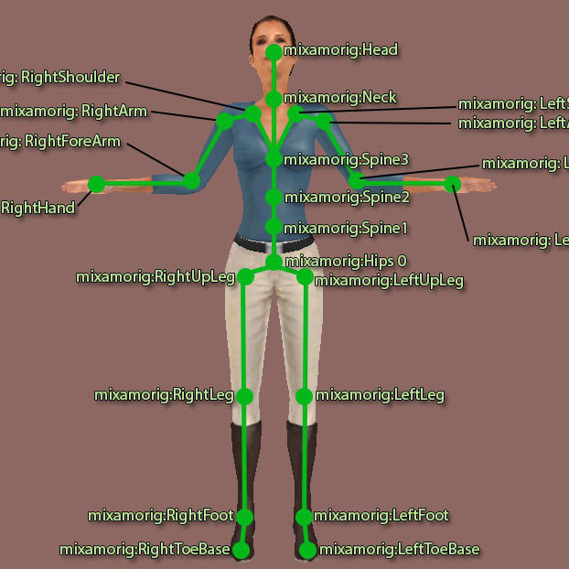
How can we control characters?
To control any character we need to rig this character.
Rigging refers to the process of creating the bone
structure of a 3D model.
There are websites and Unity assets that offer
ready-rigged characters like Mixamo.
Also Mixamo offers animations that are standard for most uses.

Slide 81
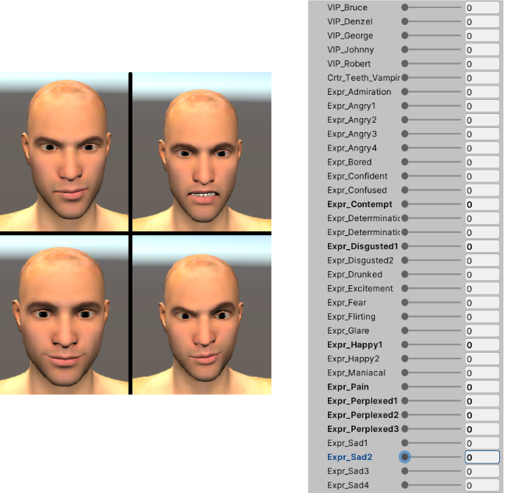
Blendshape Characters
There were no face animations available in Mixamo.
Rigging for facial expressions requires making a controller for every muscle which is very intensive.
Blendshape characters that offered controlling the
facial expressions by changing a value of variables.
Blendshape characters are very complex and uses a
lot of memory.

Slide 82
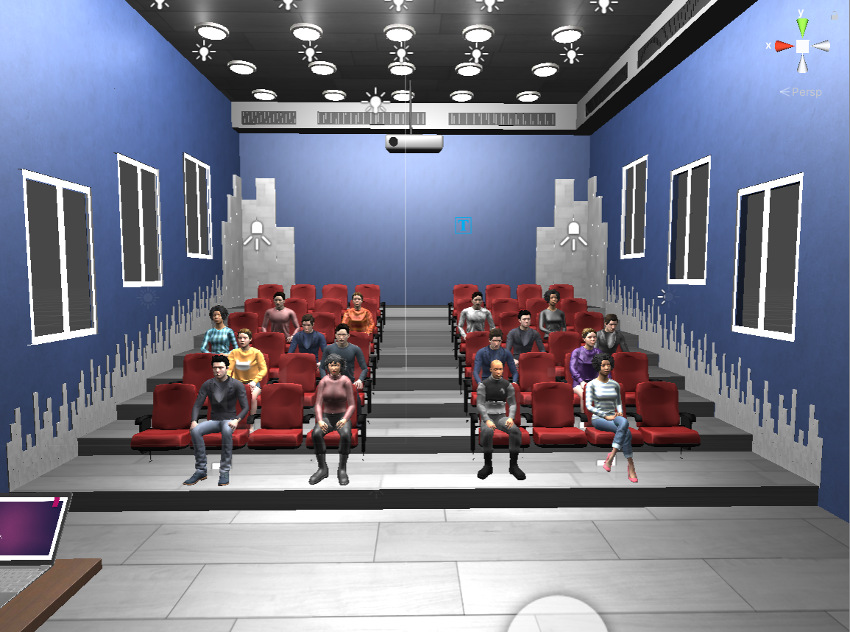
The Final Scene

Slide 83
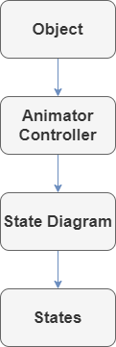
Animation
Facial Expressions are a part of a more general subject called animations.
Animations is the process of moving any object, either a character raising its hand, a door opening, a car moving etc.
We animate an object by recording a movement (transition, rotation, scaling) through time and saving this movement as an animation and applying this animation to the object.

Slide 84
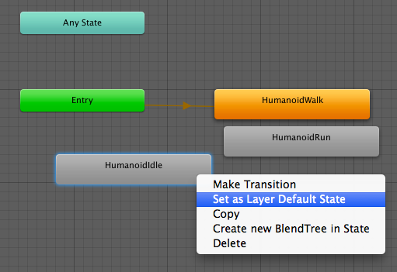
The State Diagram
The object can move from one animation to another using State Machine Diagram.
Each state represents an action, we can transit from a state to another after some condition is satisfied.
We add control is through parameters which are variables that are defined within the animator that scripts can access and assign values to.

Slide 85

Animation Layers
Unity uses Animation Layers for managing complex
state machines for different body parts.
On each layer, you can specify the mask, and the Blending type (Override or
Additive)
We have two layers in the project, the Base Layer and the Face Layer.

Slide 86


The Base Layer
The Base Layer in our project consists of transition between 3 animations, Idle Sitting, Raise Hand, Talk.

Slide 87





The Face Layer
The Face Layer in our project consists of transition between different facial expressions.

Slide 88
Scene Optimization

Slide 89

Scene Optimization
Good and stable performance is critical to the success of any application.
Performance of applications can be measured by how many frames are drawn per second (FPS).
Computer application or games should have an FPS of 30 to 60
VR requires higher FPS rate (60 - 90)

Slide 90

Scene Optimization
In unity the FPS depends on how many batches (draw calls) are sent to the GPU to be drawn.
Although a single draw call is very cheap computationally, the render state changes are very expensive.
A draw call contains all the info required to draw an object on the screen.
A batch is a combination of draw calls with the same info.

Slide 91
Controls the quality of the rendered image
Camera
Level of detail of an object
Scene Optimization
Textures
The number of objects in scene and their behavior
Objects
The amount of light hitting an object
Lighting

Slide 92


Scene Optimization (Camera)
Unity offers multiple rendering path options with different capabilities and performance characteristics
Forward Vs Deferred rendering with respect to lighting calculations
Size of camera sensor also contributes to draw calls count

Slide 93


Scene Optimization (Texture)
Textures are images that lay over or wrap around an object to give them a visual effect.
Texture quality and size can also cause overhead in drawing objects.

Slide 94


Scene Optimization (Objects)
Every object causes at least one draw call.
Static vs Dynamic objects with respect to calculations.
Identical objects can be combined into one single object via Mesh Combining and Mesh Simplification.
Combined objects are all drawn in a single draw call.

Slide 95

Scene Optimization (Lighting)
Lighting calculations are computationally expensive.
Static objects can make use of baked light settings.
Shadow also causes overhead to the draw calls and for simplicity can be excluded from our scene.

Slide 96

Scene Optimization
Optimization is done in multiple steps to enhance the scene for a better user experience.

Slide 97


Final Touches
Intro scene is added for a better user experience
Minor modifications to lecture scene
Options screen to give user more control over the application.

Slide 98
Application Demo

